Slide 1

Welcome to
Th Rogers
Orchestra
Director Joyce Myoung Jang

Slide 2
Ms. Jang is very happy to know you
Orchestra director at TH Rogers Middle School.
Professional Violinist
Masters of Music Performance in violin major, Rice University
This is year 10 of teaching at public school
Performed at Aspen Music Festival, Tanglewood Music Festival
My favorite thing to do is playing and teaching music. So, being here with my students means a lot to my life. I have a huge pride of serving public school music education from a orchestra trained, conservatory background.

Slide 3
th Rogers orchestra
History of 30+ years
Region 23
In 2021, chamber orchestra brought UIL sweepstakes trophy.
Field trips
Active performance schedule and homeroom practice
Open to all students-5 different levels.
All students know how to read music.

Slide 4
Class routines and grade
“NO students should fail from music class” but I believe students will practice at home with their assignments.
Grading policy
    30% Performance
    30% Rehearsal
    30% Playing test/quizzes/in class assignments
    10% Binder check (announced, unannounced)
Example of grade in cycle:
2 binder check, 2-3 playing test, Rehearsal grade, Some class assignment

Slide 5
What do we need to have in class
Instrument
Book
Binder (to keep and organize music)
Pencil
Extra paper

Slide 6
Orchestra performance Schedule
All students: two concerts each year. December (Winter concert), May (Spring concert)
October: Chamber orchestra is invited to perform at Hauncert at Bellaire HS
Halloween Homeroom concert-all orchestras
February: HISD Beginning Orchestra Festival at Meyerland
March: UIL Sight reading and Concert Contest (Chamber and Sinfonia)

Slide 7
Th Rogers Orchestra
I love our orchestra students and culture in our classroom
Orchestra teaches music, respect, organization, disciplines, time management, multitasking, motor skills etc. We learn how to unite with music and create a beautiful culture and community here.
There is a statistic fact that music students get above average SAT scores, and orchestra students get the highest in this group. See the information from Texas Music Educator Association on next slide.

Slide 8

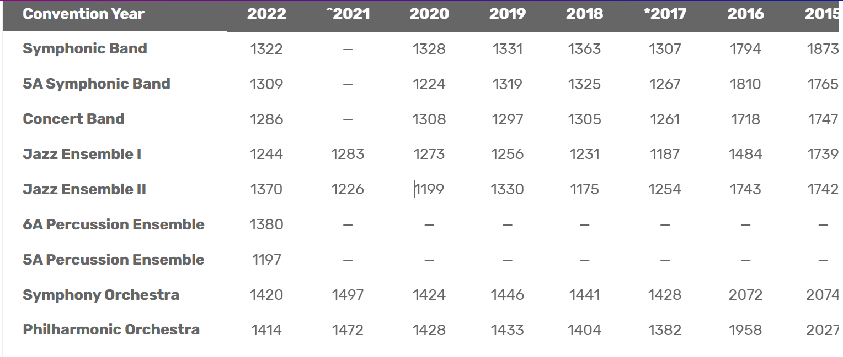


Slide 9

How to reach and share information
Email-mjang@houstonisd.org
Instragram: Throgers_orchestra

